Slide 1



AJAX
Mark J. Buckler
OCPJP,CIWJS

Slide 2

Credits
Some of the contents of this slide presentation have been referenced and reproduced from the textbook for this course, JavaScript (Sixth Edition) , Sasha Vodnik and Don Gosseling, ©2015, 2011, Cengage Learning, All Rights Reserved. ISBN 978-1-305-07844-4.

Slide 3
LEARNING OBJECTIVES
Describe the steps involved in using AJAX to update data
Create an HTTP request and interpret an HTTP response
Request and receive server data using the XMLHttpRequest object
Process data received from a web service and add it to the DOM
Update app data using JSON-P

Slide 4
Introduction to AJAX
Description
Allows client web pages to quickly interact and exchange data with a web server
Without reloading entire web page
Relies on
Client-side programming language, such as JavaScript
Data interchange format such as JSON or XML

Slide 5
Introduction to AJAX
Implementation
XMLHttpRequest object (XHR object)
Uses HTTP to exchange data between a client computer and a web server
Can be used to request and receive data without reloading a web page
Combining XMLHttpRequest with DHTML
Allows update and modification to individual portions of a web page
Employs data received from a web server

Slide 6
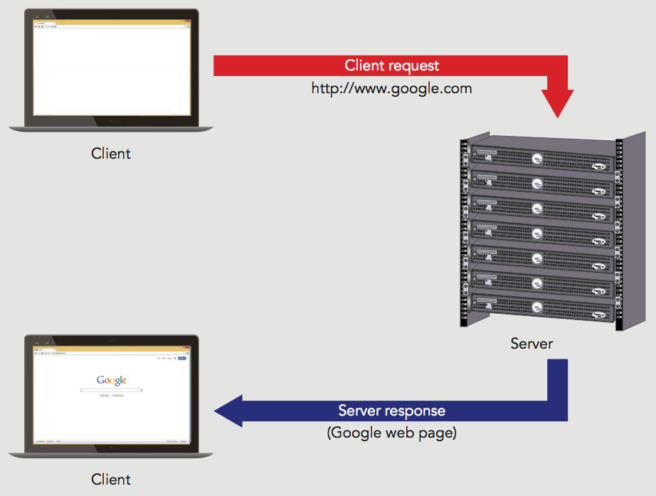
Introduction to AJAX
Standard HTTP Request

Slide 7
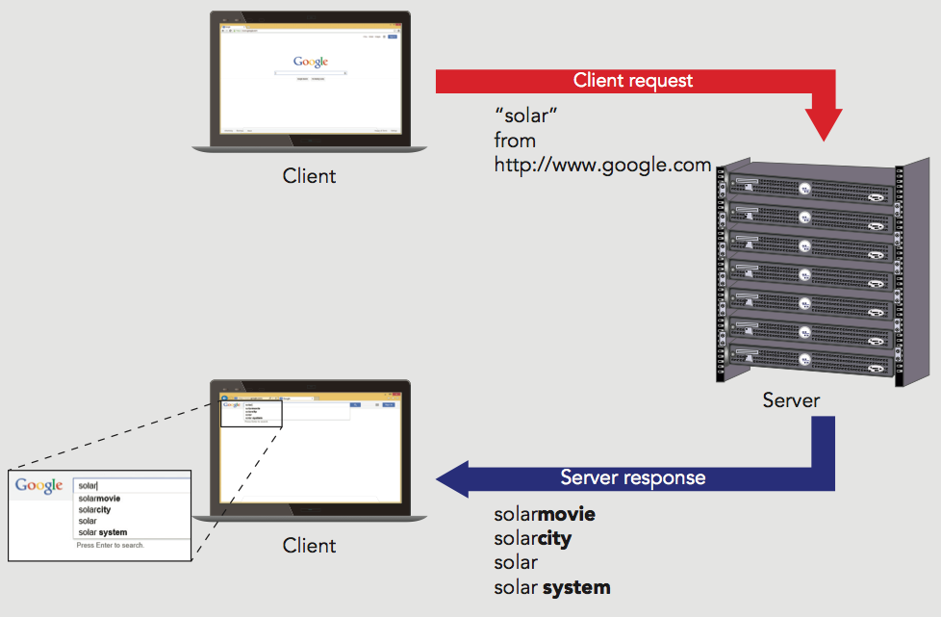
Introduction to AJAX
HTTP Request with the XHR Object

Slide 8
Introduction to AJAX
Limitations
Data requested can be located on a third-party server
Not all web servers or browsers support this
Can use a server-side script as a proxy to access data from another domain
Proxy
Server that acts for or performs requests for other clients and servers
Proxy scripts are often written in PHP
Language specifically designed to run on web servers

Slide 9
Introduction to AJAX
Web Services
Data source made available on one domain for use on other domains across web
Does not contain graphical user interface or command-line interface
Simply provides services and data in response to requests
Up to the client to provide an implementation for a program calling a web service
Often requires API key
Unique identifier assigned by service to each person/organization that wants access

Slide 10
Introduction to AJAX
Running AJAX from a Web Server
Must open AJAX files from a web server
Utilize the HTTP (http://) or HTTPS (https://) protocol
Traditional web server software
Apache HTTP Server: LAMPP Stack
Microsoft Internet Information Services: IIS
Emerging Web Stack Technologies
Ruby on Rails
Node.js
React

Slide 11

Introduction to AJAX
Programming Exercise 01_11_01 – Step 1
Exercise Setup

Slide 12
Working with HTTP
Employing AJAX Involves 4 steps
Instantiate an XMLHttpRequest (XHR) object for the web browser where the script will run
Use the XMLHttpRequest object to send a request to the server
Receive the response from the server containing the requested data
Process the data returned from the server, and incorporate the data into the app

Slide 13
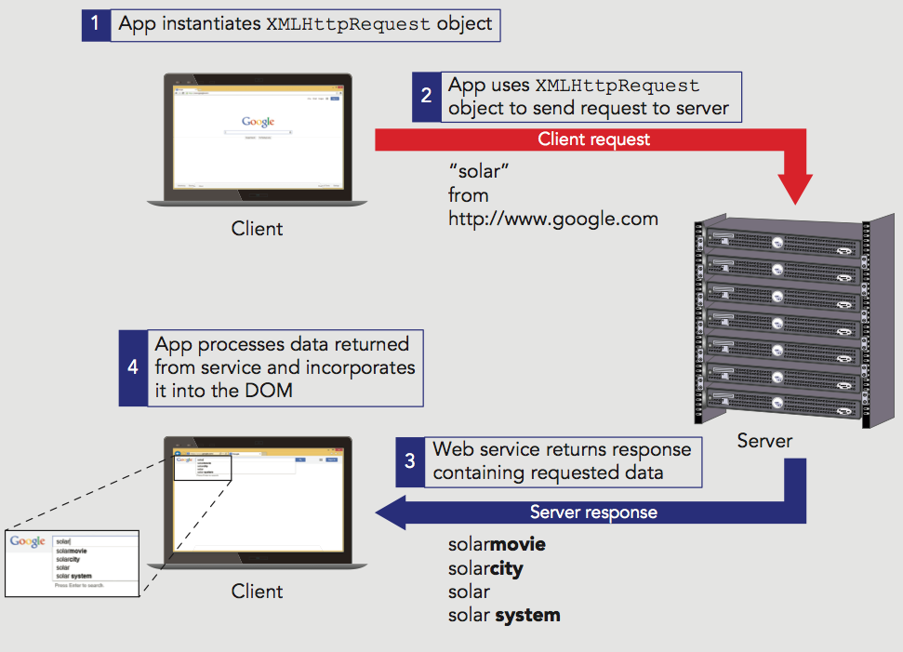
Working with HTTP
Using AJAX to Update Data

Slide 14
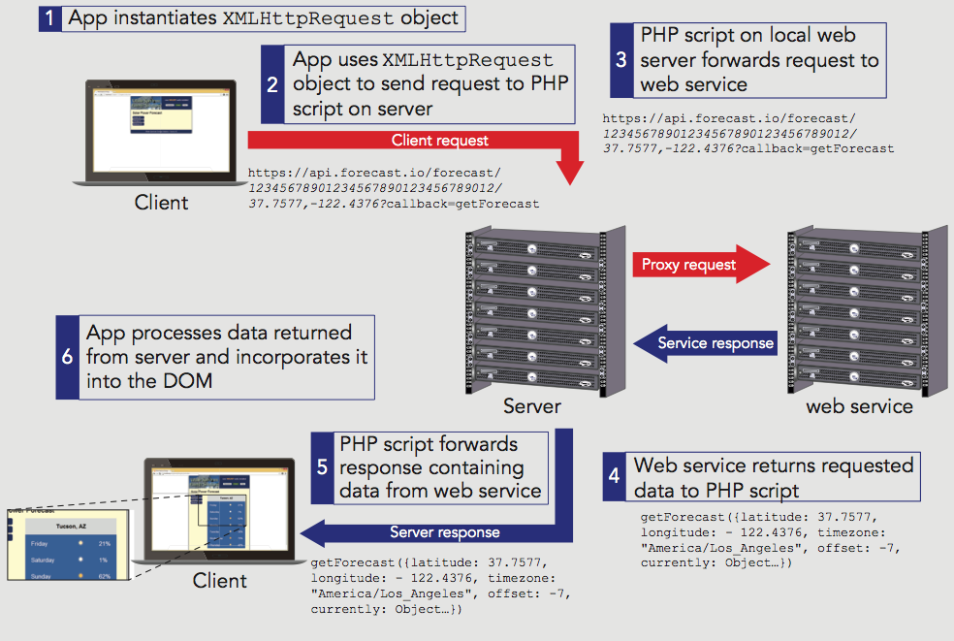
Working with HTTP
Using AJAX with a Proxy Server to Update Data

Slide 15
Working with HTTP
Request
Process of asking for a web page from a web server
Response
Web server’s reply
Uniform Resource Locator (URL)
A web page's unique address
Consists of two parts
Protocol (usually HTTP)
Web server’s domain name or a web server’s Internet Protocol address

Slide 16
Working with HTTP
Hypertext Transfer Protocol (HTTP)
Set of rules defining how requests are made by an HTTP client to an HTTP server
Defines how responses are returned from an HTTP server to an HTTP client
HTTP Client
Refers to the application (web browser) making the request
HTTP Server or Web Server
Refers to a computer that receives HTTP requests and returns responses to HTTP clients

Slide 17
Working with HTTP
HTTP Messages
Consist of client requests and server responses
HTTP client opens a connection to the server
Submits a request message
Web server returns a response message appropriate to the request type
Format
Start line (request method or status returned)
Header lines (zero or more)
Blank line (always follows last header line)
Message body (optional)

Slide 18
Working with HTTP
HTTP Message Headers
Define information about the request or response message and about the contents of the message body
47 HTTP 1.1 headers
Generic headers used in request or response messages
Headers specific to a request, response, or message body
Format: name/value pairs
header: value

Slide 19
Working with HTTP
HTTP Message Headers
Cache-Control header
Specifies how a web browser should cache any server content it receives
Caching
Temporary storage of data for faster access
Web browser attempts to locate any necessary data in its cache first, before making a request from a web server
Defeats the purpose for using AJAX
Include Cache-Control: no-cache header

Slide 20
Working with HTTP
Programming Exercise 01_11_01 – Step 2 Examining HTTP Messages

Slide 21
Working with HTTP
HTTP Requests
Most common types of HTTP requests
GET
POST
PUT
DELETE
There are others, but we will mostly work with these

Slide 22
Working with HTTP
HTTP Requests
GET method
Used for standard web page requests
Can have a query string or form data appended to the URL
Insecure, visible in the URL bar
POST request
Similar to a GET request except that any submitted data is included in the message body
Immediately following the blank line after the last header

Slide 23
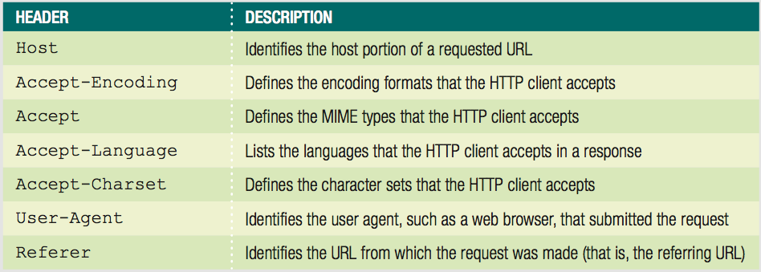
Working with HTTP
Common HTTP Request Headers

Slide 24
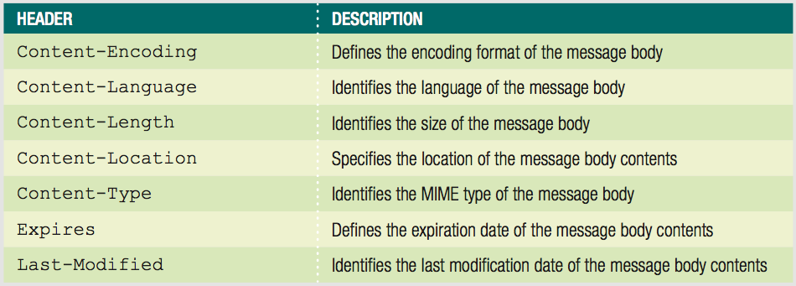
Working with HTTP
Common HTTP Message Body Headers

Slide 25
Working with HTTP
Programming Exercise 01_11_01 – Step 3
Examining HTTP Requests

Slide 26
Working with HTTP
HTTP Responses
Take the same format as request messages
Return protocol and version of the HTTP server
Along with a status code and descriptive text
Status codes format
1xx: (informational) - Request received
2xx: (success) - Request successful
3xx: (redirection) - Request cannot be completed without further action
4xx: (client error) - Request cannot be fulfilled due to a client error
5xx: serious trouble of some type

Slide 27
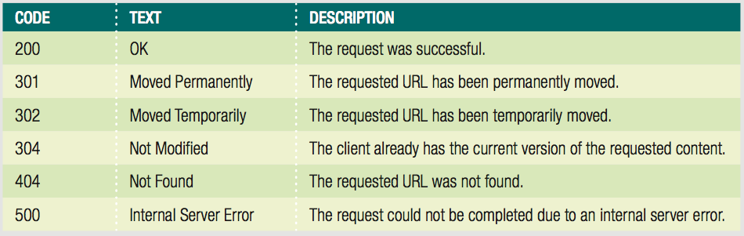
Working with HTTP
Common Response Status Codes

Slide 28
Working with HTTP
Programming Exercise 01_11_01 – Step 4
Examining HTTP Responses

Slide 29
Working with HTTP
Programming Exercise 01_11_01 – Step 5
Examining PHP Proxy and Getting API Key

Slide 30
Requesting Server Data
The XMLHttpRequest Object
Basis of incorporating AJAX into JavaScript code
Allows use of use JavaScript and HTTP to exchange data between a web browser and a web server
Encapsulates methods and properties to facilitate the exchange process

Slide 31
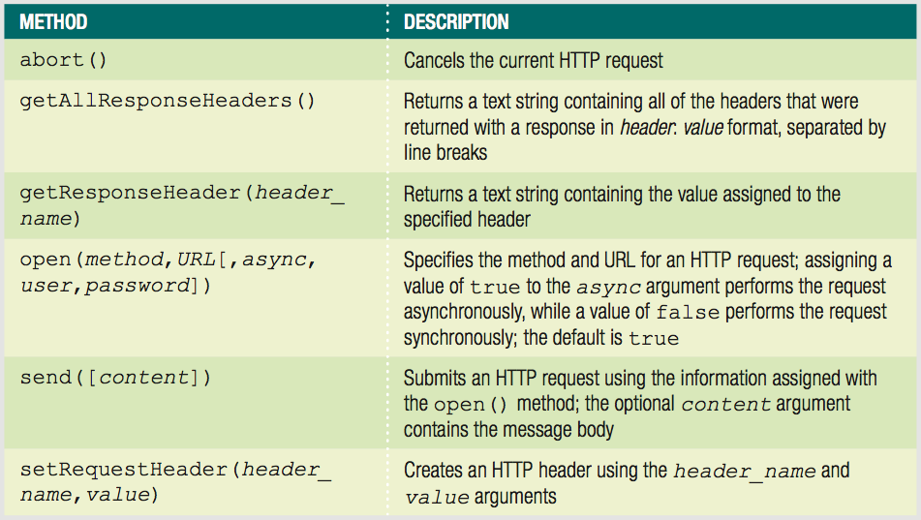
Requesting Server Data
The XMLHttpRequest Object Methods

Slide 32
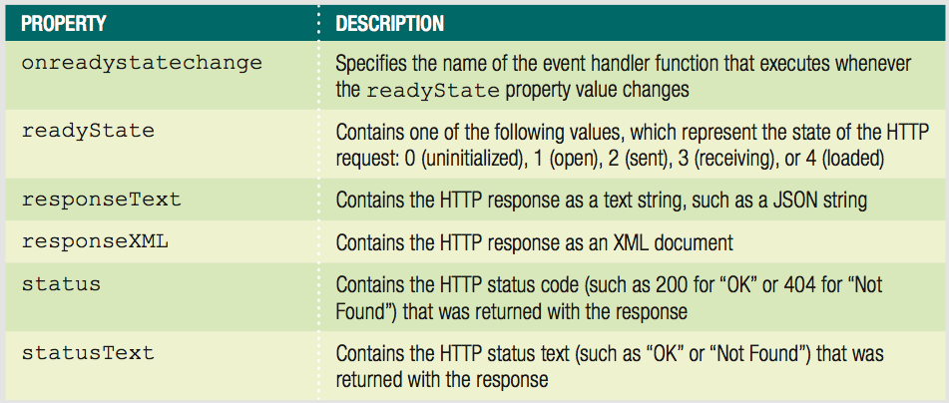
Requesting Server Data
The XMLHttpRequest Object Properties

Slide 33
Requesting Server Data
Instantiating an XMLHttpRequest Object
Use the XMLHttpRequest constructor var httpRequest = new XMLHttpRequest();
Most JavaScript programmers use a series of nested try / catch statements
Opening and closing HTTP connections can be a bottleneck in page loading
HTTP/1.1 automatically keeps the client-server connection open unless it is specifically closed
Can make AJAX programs faster by reusing an instantiated XMLHttpRequest object

Slide 34
Requesting Server Data
Programming Exercise 01_11_01 – Step 6
Instantiating an XMLHttpRequest Object

Slide 35
Requesting Server Data
Opening and Sending a Request
abort() method should be used when reusing an XHR object
Used to cancel any existing HTTP requests before beginning a new one
Use the open() method with the instantiated XMLHttpRequest to target server resource
First required argument is request method (GET or POST)
Second required argument is server target URL
Accepts three optional arguments: async (default true, username, password

Slide 36
Requesting Server Data
Opening and Sending a Request
send() method
Submits the request to the server
Accepts a single argument containing the message body
If there is no body, use null as the argument
POST requests more involved
Must manually build name-value pairs to submit as they are not appended to the URL
Must submit at least Content-Type header before send() method to specify body MIME type
Also should submit Content-Length header and Connection header to keep connection open or close

Slide 37
Requesting Server Data
Programming Exercise 01_11_01 – Step 7
Opening and Sending a Request

Slide 38
Receiving Server Data
XMLHttpRequest Data Properties
responseXML property
Contains the HTTP response as an XML document
Only if server response includes the Content-Type header with a MIME type value of text/xml
responseText property
Contains the HTTP response as a text string

Slide 39
Receiving Server Data
Processing the Data
XML
Assign property values to document nodes
First assign value of responseXML property to variable
Use innerHTML and node properties to assign values of XML document stored in variable to appropriate elements
Text
responseText value almost always a JSON string
Use JSON.parse() method to convert to JS object
Then access property values of new object and add to DOM elements

Slide 40
Receiving Server Data
Synchronous Requests and Responses
Synchronous request
Stops the processing of the JavaScript code until a response is returned from the server
Check XMLHttpRequest object’s status property value to ensure response received successfully
Synchronous response
Easier to handle
Drawback is script will not continue processing until the response is received

Slide 41
Receiving Server Data
Asynchronous Requests and Responses
Asynchronous request
Allows JavaScript to continue processing while it waits for a server response
Create an asynchronous request
Pass a value of true as the third argument of the open() method
Or omit the argument altogether

Slide 42
Receiving Server Data
Asynchronous Requests and Responses
Receive a response
Use the XMLHttpRequest object’s readyState property and onreadystatechange event
Value assigned to the readyState property is updated automatically
If property assigned a value of 4, response finished loading

Slide 43
Receiving Server Data
Programming Exercise 01_11_01 – Step 8
Processing Response Data

Slide 44
Receiving Server Data
Programming Exercise 01_11_01 – Step 9
Adding Response Data to the Page

